Slide 1
Cosine Transform and Its Applications
Instructor
LE Thanh Sach, Ph.D.
Ltsach@cse.hcmut.edu.vn

Slide 2
Outline
Discrete Cosine Transform (DCT)
Its Applications

Slide 3
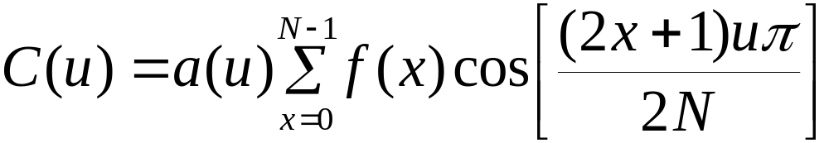
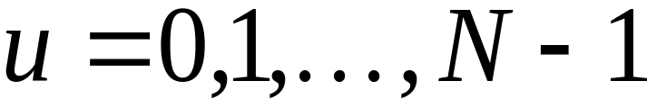
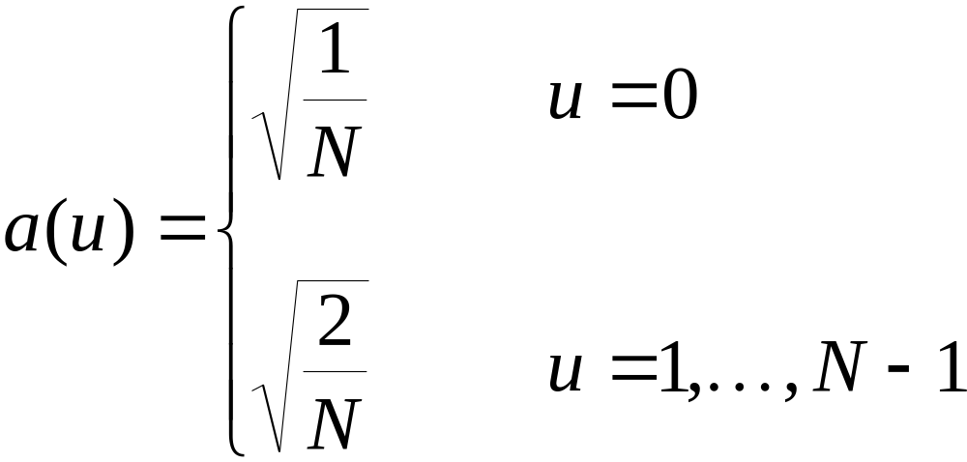
1-D DISCRETE COSINE TRANSFORM
DCT

Slide 4
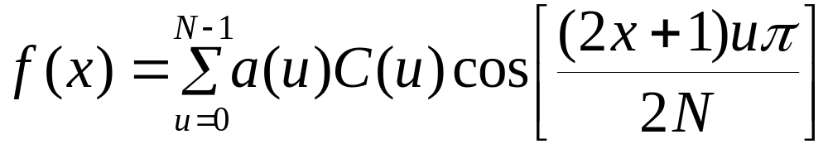
1-D INVERSE DISCRETE COSINE TRANSFORM
IDCT

Slide 5
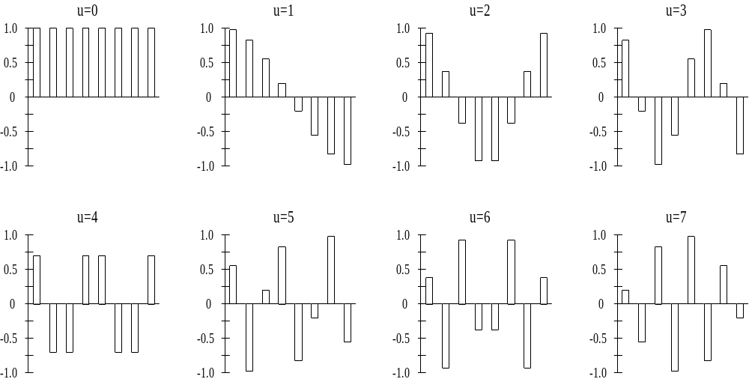
1-D Basis Functions N=8

Slide 6
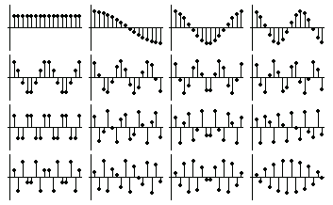
1-D Basis Functions N=16

Slide 7

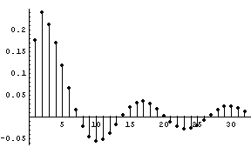
Example: 1D signal

Slide 8
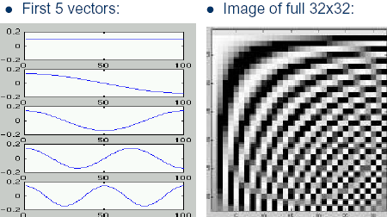

Slide 9

2-D DISCRETE COSINE TRANSFORM
DCT

Slide 10
ADVANTAGES
Notice that the DCT is a real transform.
The DCT has excellent energy compaction properties.
There are fast algorithms to compute the DCT similar to the FFT.

Slide 11
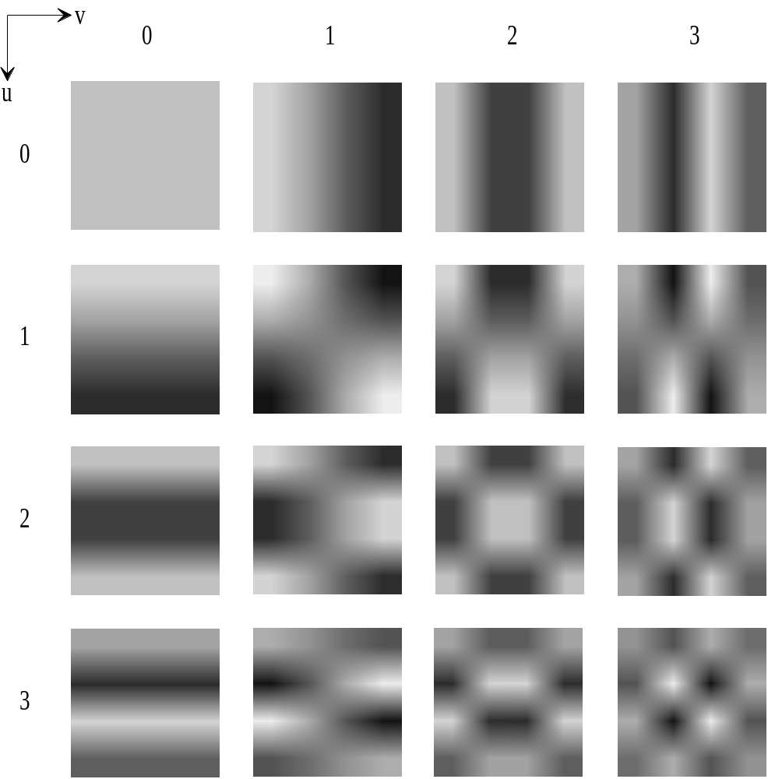
2-D Basis Functions N=4

Slide 12
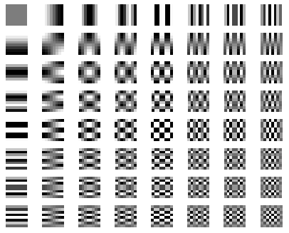
2-D Basis Functions N=8

Slide 13
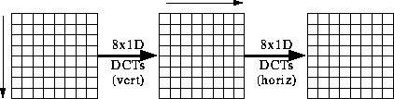
Separable

Slide 14
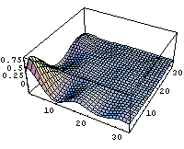
Example: 2D signal

Slide 15

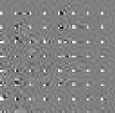
8x8 Block DCT

Slide 16
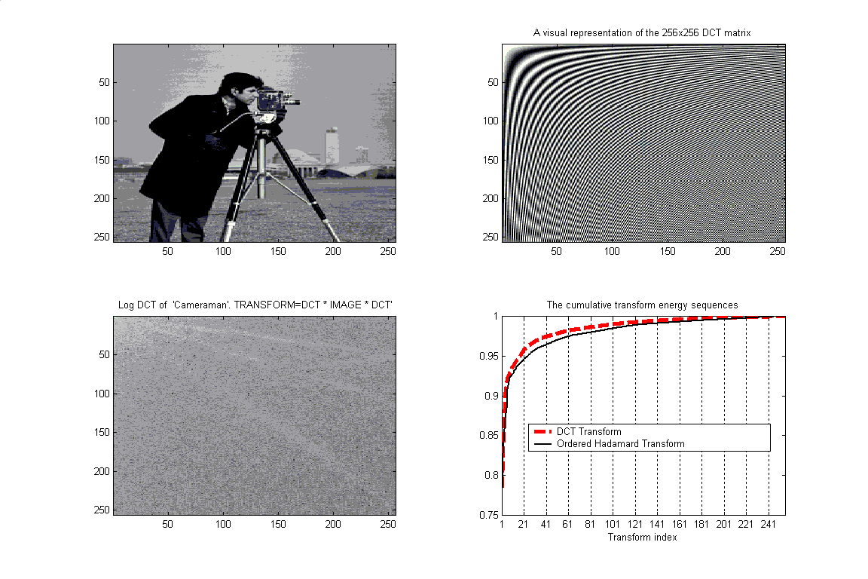

Slide 17
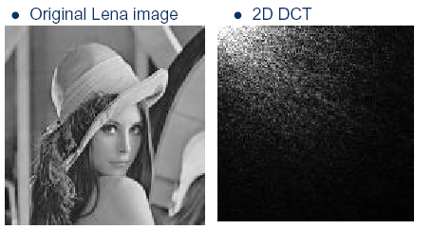
Example: Energy Compaction

Slide 18
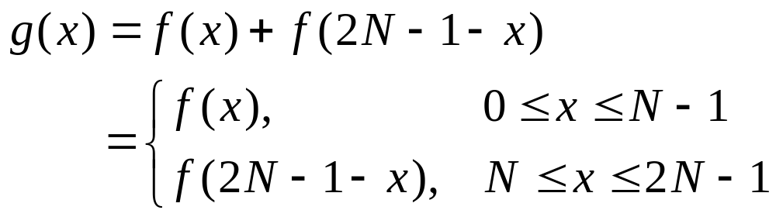
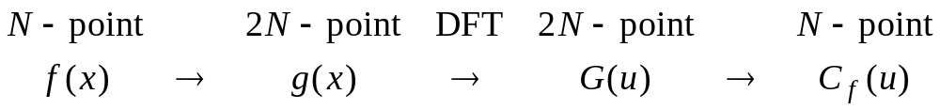
Relation between DCT and DFT
Define

Slide 19
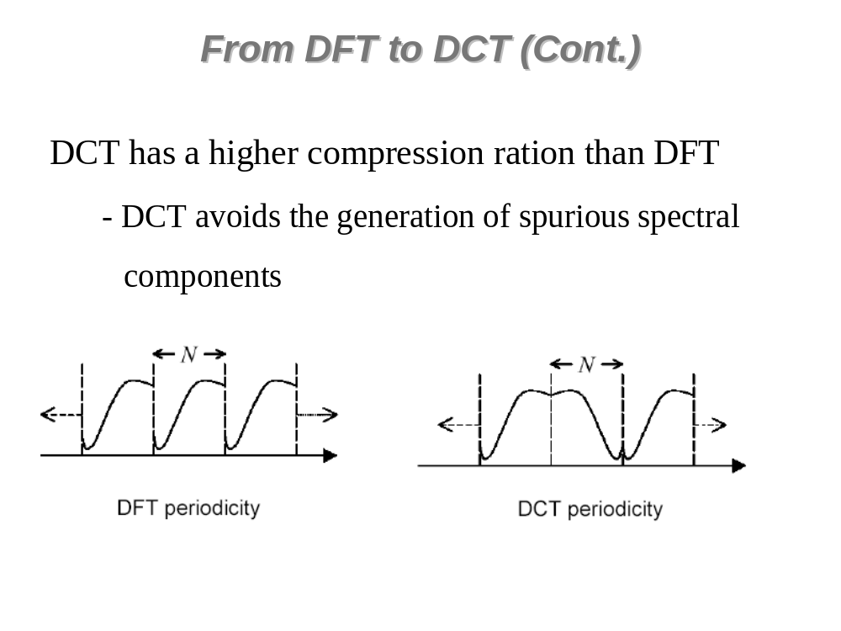

Slide 20
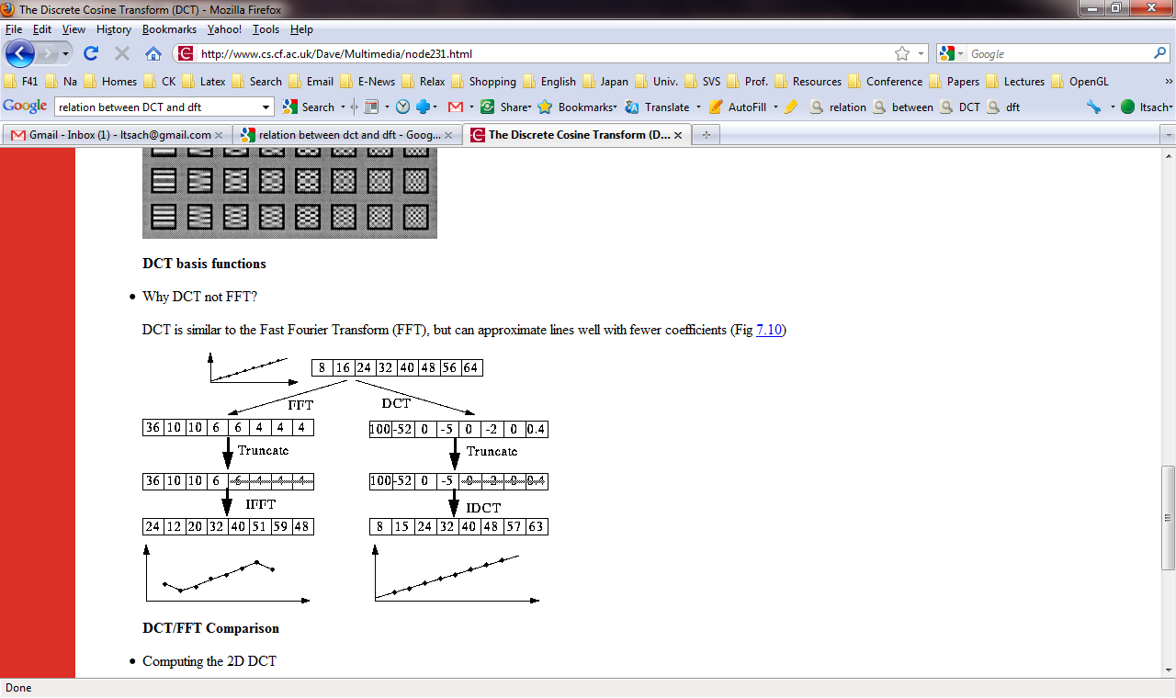
DCT vs. DFT

Slide 21
